Slide 1
REINFORCEMENT LEARNING
CONTINUOUSLY ADAPTIVE CONVERGENCE TO DRIVE THE BEST ACTIONS
John Hebeler, PhD Lockheed Martin Fellow john.w.hebeler@lmco.com

Slide 2
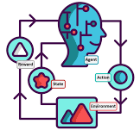

Agenda
RL Defined and Compared
RL Applied
RL Types
RL Vocabulary
RL Demonstrations
Summary
Code available at…

Slide 3
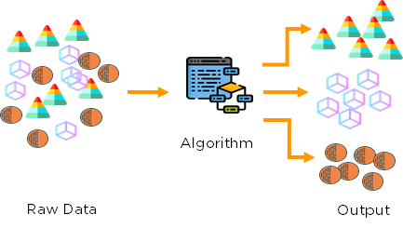
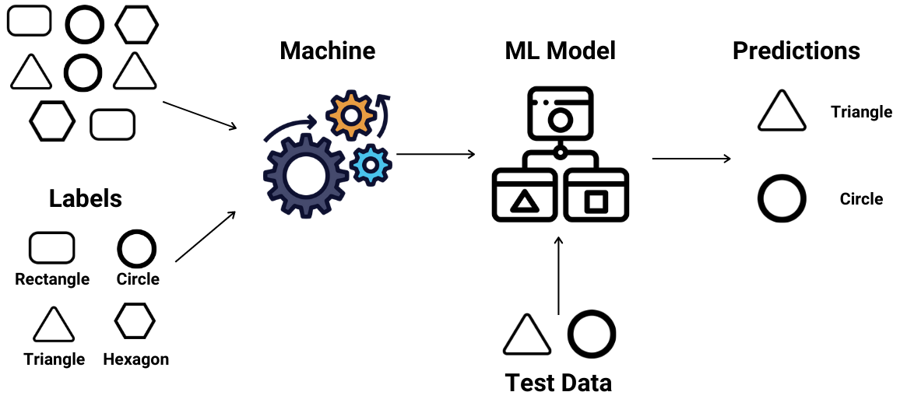
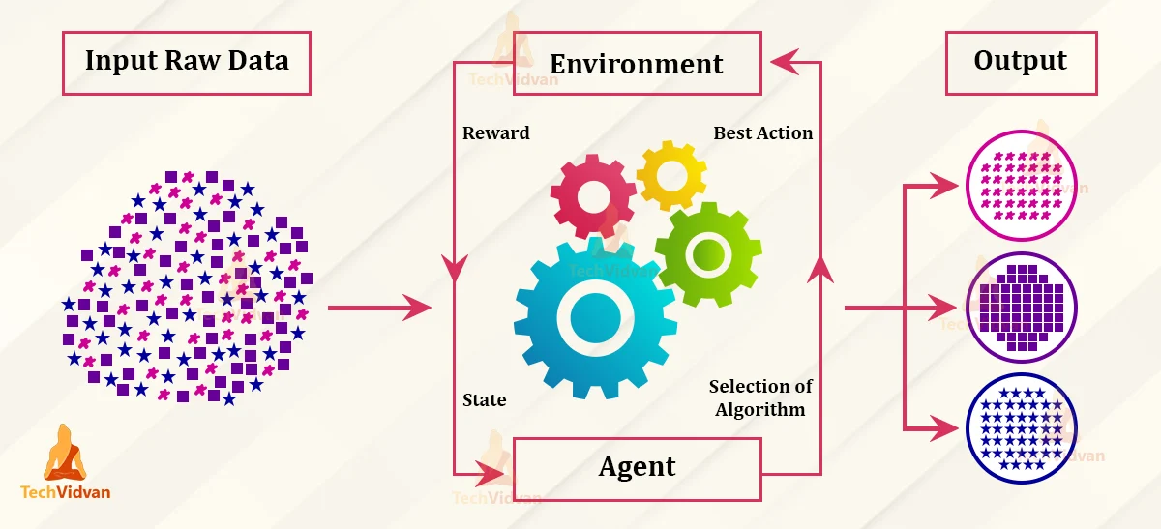
ML Types
Notes:
RL: Supervised with delayed label, Learn from experience - no new knowledge, trial and error, adopt to uncertain, dynamic environments
Examples where RL is more effective: Games, robot deciding conflicting actions, and recommendation systems, self-driving cars
Limits on RL: Extensive training, Not easy or very expensive to simulate some environments (car), real environments too risky And it is a simulation which is only an approximation
Actions may not be discrete
Optimization for a local minima is harder than ordinary DL

Slide 4
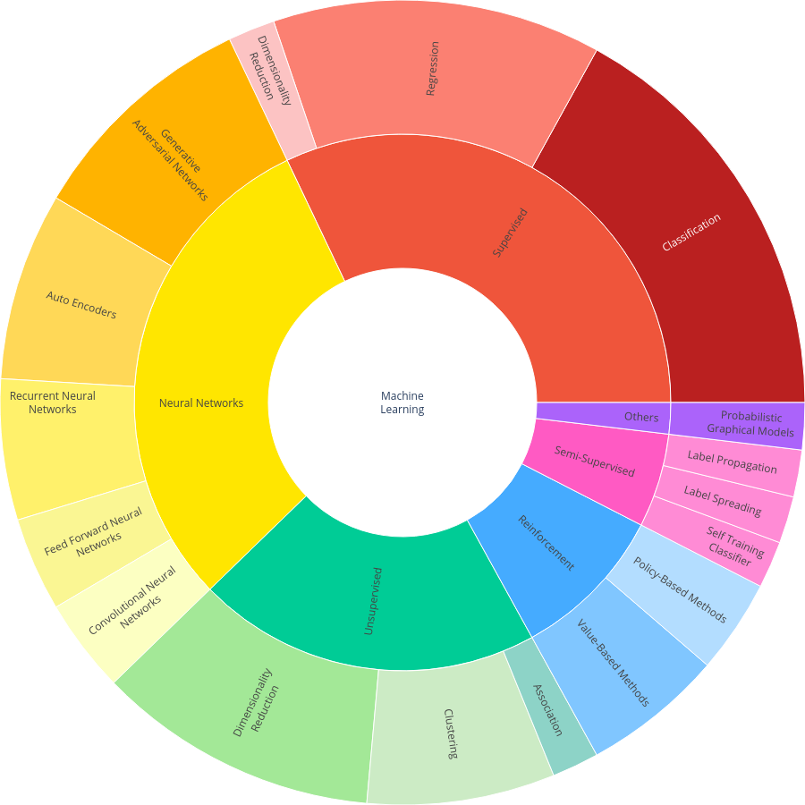
https://plotly.com/~jhebeler/1/

Slide 5
RL Vocabulary
Environment
Agent
Action Space
Explore or Exploit
State (Observation Space) and Done State
Reward or Punishment
Policy
Plan
Episode
Goal
Notes:
Environment - rules and surrounding info Think of a checker board
Policy - strategy to achieve the goal for example random policy
Plan - collection of policies/actions taken so far
Episode - agent reaches done or dead state (maximum number of actions)
Explore - take random action
Exploit - take best action of known possibilities

Slide 6

Key Question in Designing RL
How do I define a goal and a reward?
How do I make the agent act?
How do I model the environment?
How do I determine the current state?
Exploration-Exploitation Trade-Off?
Policy-based methods vs Value-based methods

Slide 7
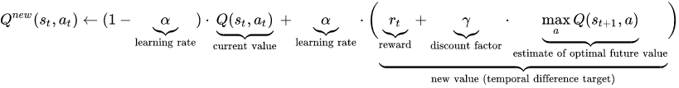
Q Learning
Epsilon (0-1) - Explore or Exploit (Raise to exploit more as things are figured out)
Alpha (0-1) - Learning Rate (Balance between new state value and previous ones)
Gamma (0-1) - Discount Factor (Increases earlier states significance)
Q-Learning Equation:
Episodes? - When table converges

Slide 8
Framing the Challenge for RL
Exercise -

Slide 9
Limitations
Training on Simulators
Actions may not be discrete
Optimizations for local minima is harder than DL

Slide 10

Demonstrations
Environment
Local Hardware and Software
Cloud setup on AWS and Azure
Tic Tac Toe
Blackjack
Pole Balancing (AWS)

Slide 11
Summary
Powerful Complement to Other ML Methods
Powerful Environments Available
Get your hands into it
Thank you! john.w.hebeler@lmco.com

